Slide 1


Leveraging ambient sensing for the estimation of curiosity-driven human crowd
Anirban Das, Kartik Narayan, Suchetana Chakraborty
Kartik Narayan B19CSE110

Slide 2
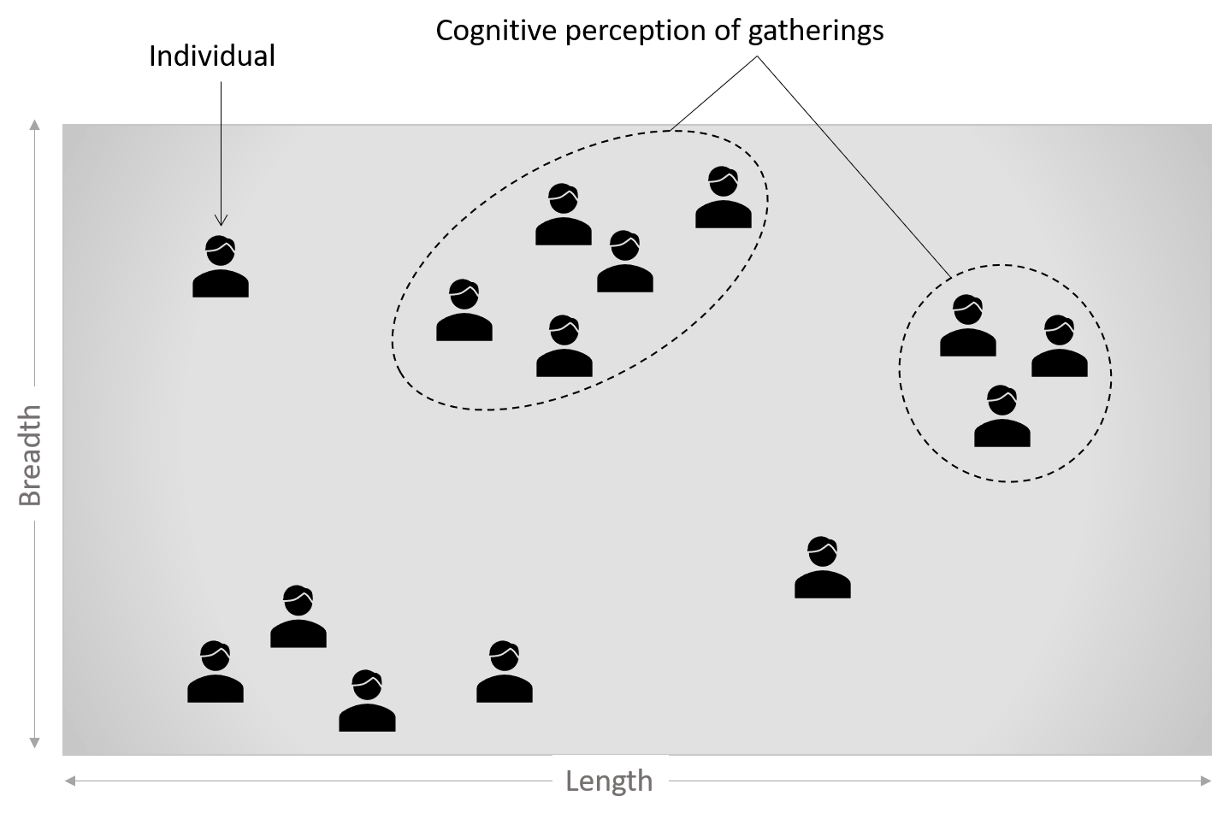
Motivation
Characterization of human crowd/gathering helps in
Smart City Applications
Infrastructure automation
Targeted Advertising
Hypermarkets
Museum
Active sensing invades privacy

Slide 3
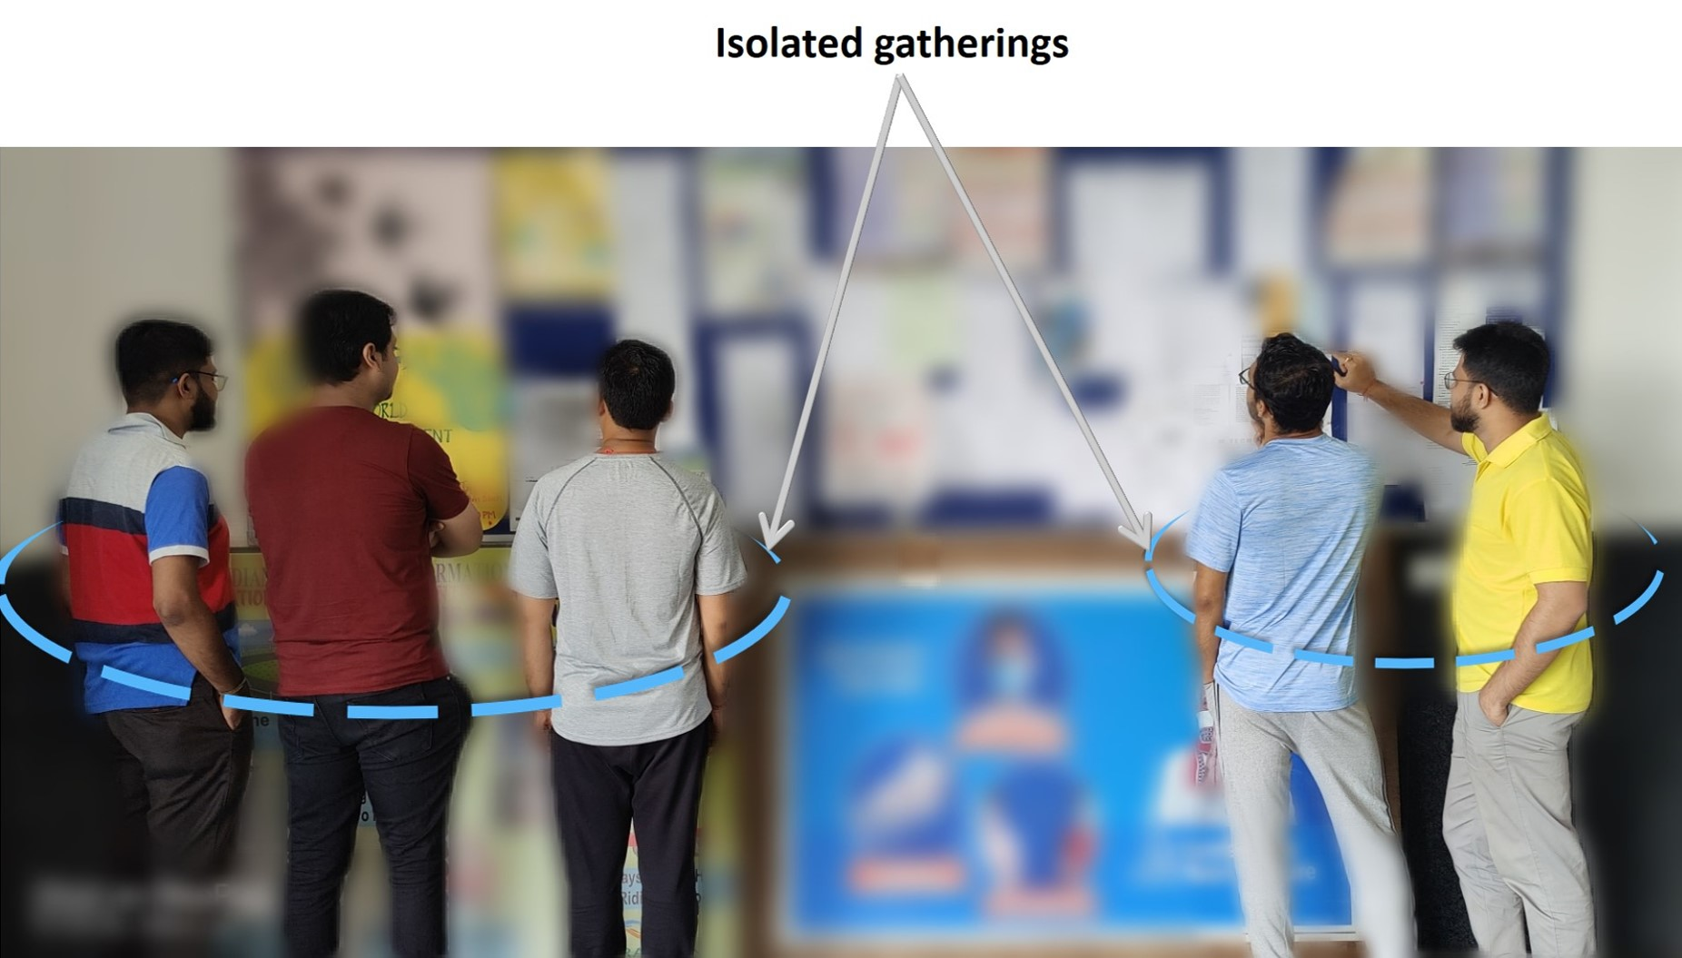
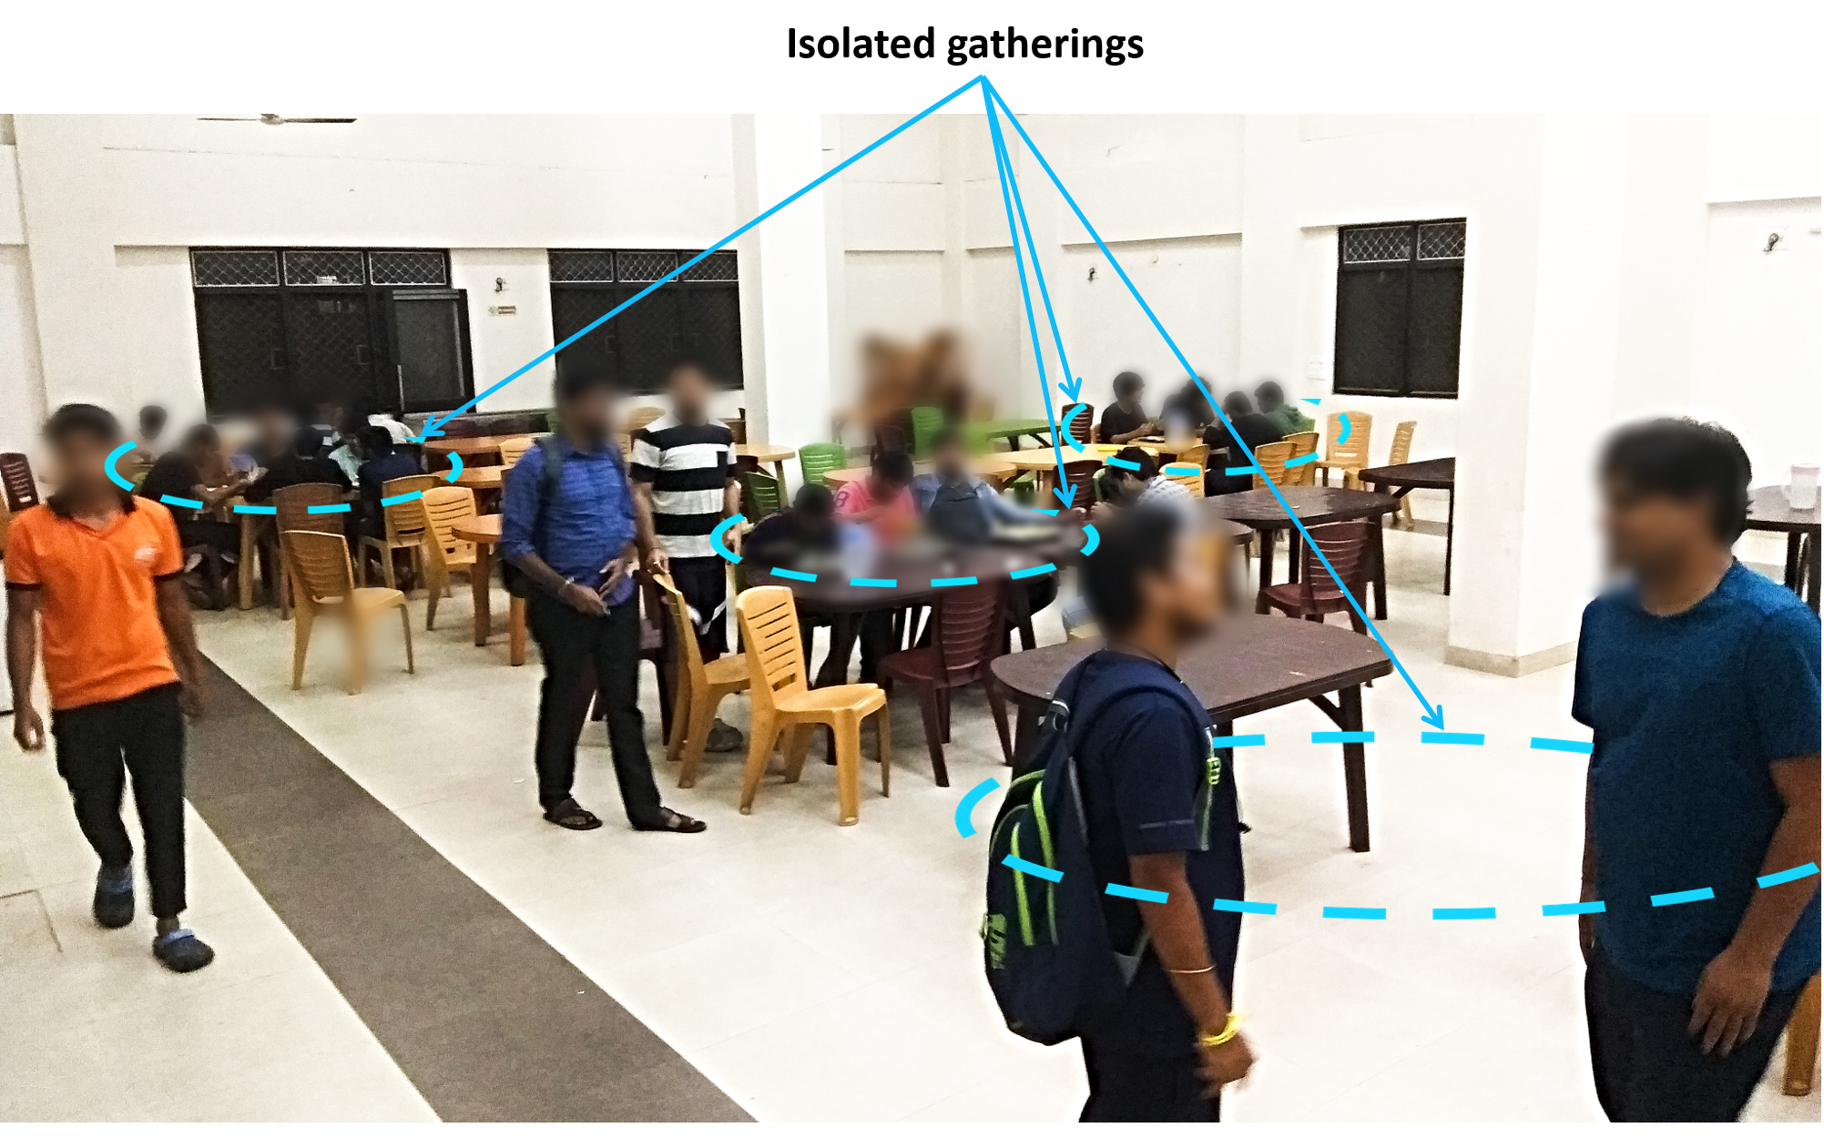
Problem Statement
We aim to develop a method towards measuring the spatio-temporal significance of an object in terms of the curious crowd it has attracted over the others.

Slide 4
Proposed Work
We developed an approach that utilizes a set of passive sensors and Wireless signal properties for the necessary estimation of curiosity driven human crowd.
We have validated the idea using a room-scale testbed with rigorous experimentation in a real-world scenario.
The proposed low cost solution has minimal invasive footprints towards privacy and is capable to reach beyond 90% of accuracy for this measurement.

Slide 5
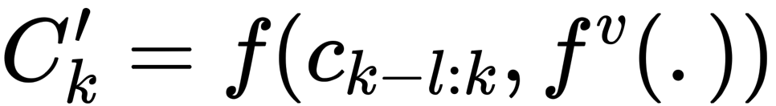
Sensors Used
CO2
Temperature
Humidity
CO2 is the most significant factor which is modelled as Here, Ck′ is the level of CO2 measured during the instance k. f(.) is a function on the parameters, ck-l:k, the sequence of CO2 measurements within the interval [tk-l, tk] of length l and fv(.). fv(.) is a function for the relevant environmental factors such as ventilation system.

Slide 6
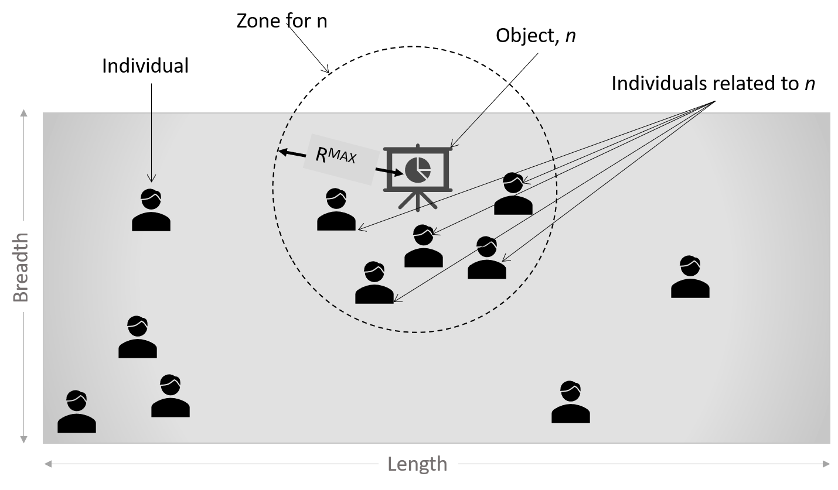
How is CO2 concentration measured

Slide 7
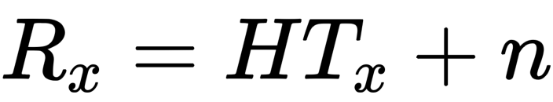
Radio signal information used
RSSI - Received Signal Strength Indicator It measures the power of the received signal after it traverses different paths.
CSI - Channel State Information Expresses compound effect of factors such as, scattering, fading and power decay. It is modelled as Where, Rx and Tx are the receive and transmit vectors, H is the channel matrix and n is the noise vector.

Slide 8
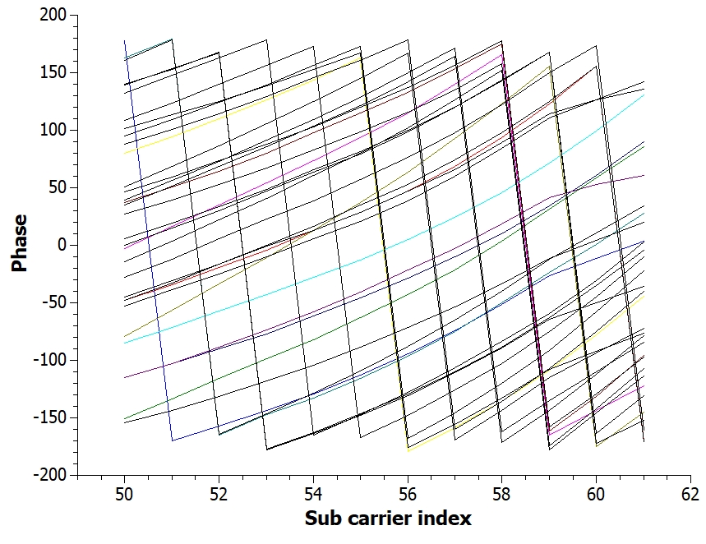
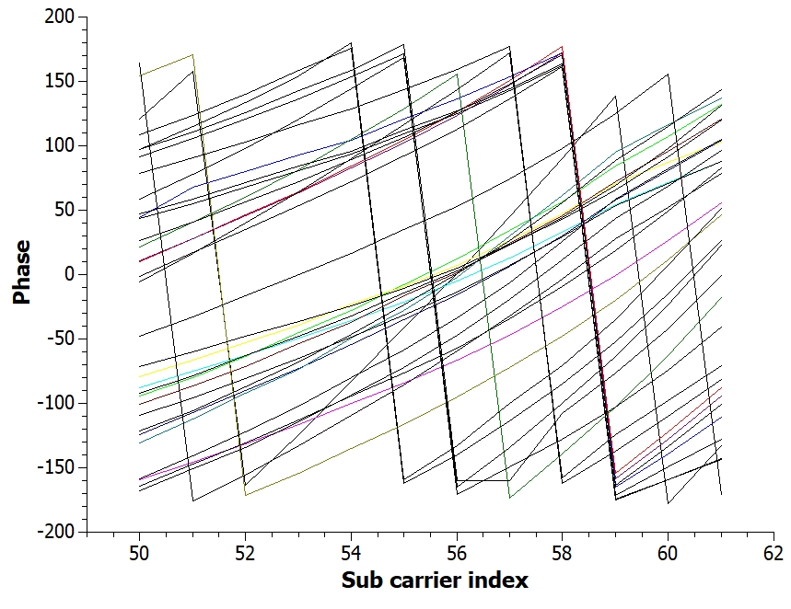
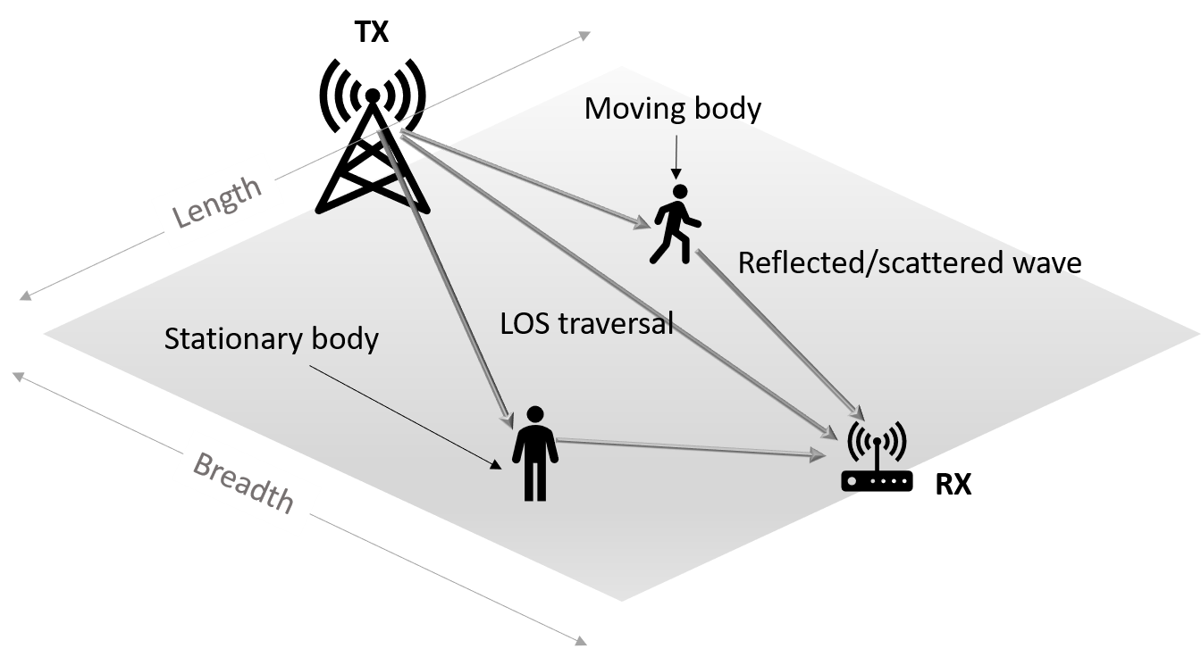
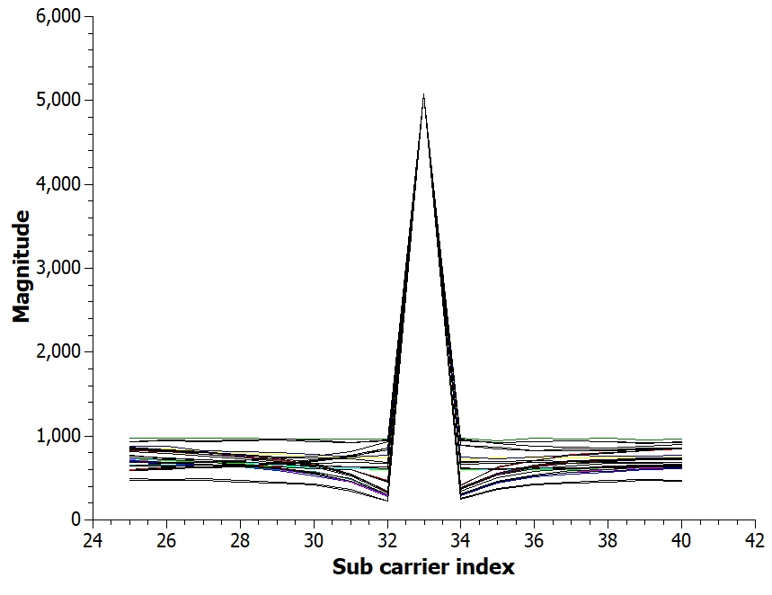
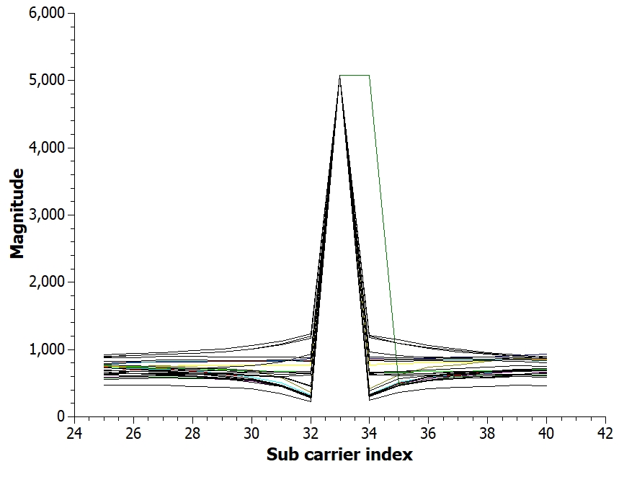
Effect of crowd on CSI values
(a)
(b)
Wave Traversal
(c)
(d)

Slide 9
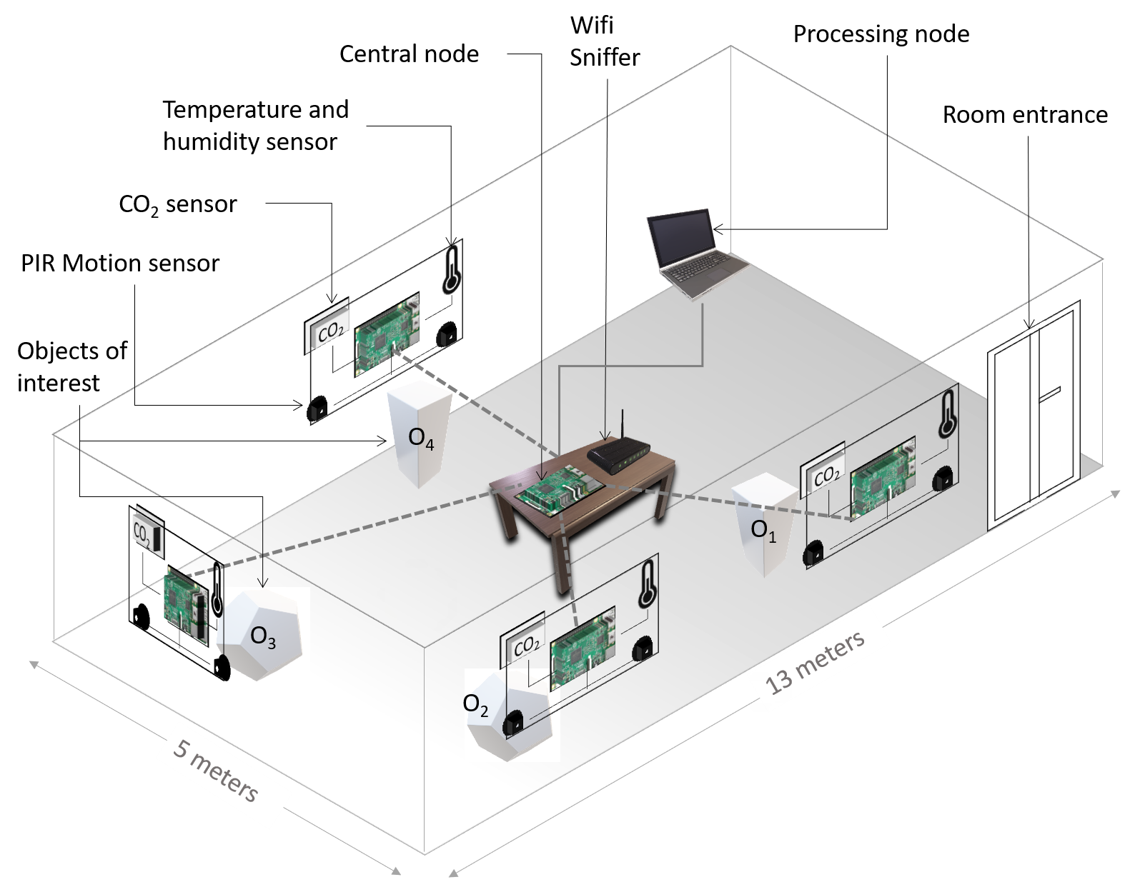
Testbed
4 Objects (O1,O2,O3,O4) 4 CO2 sensor
4 Temperature sensor
4 Humidity sensor
1 Central node
1 wifi sniffer
8 Motion Sensors

Slide 10
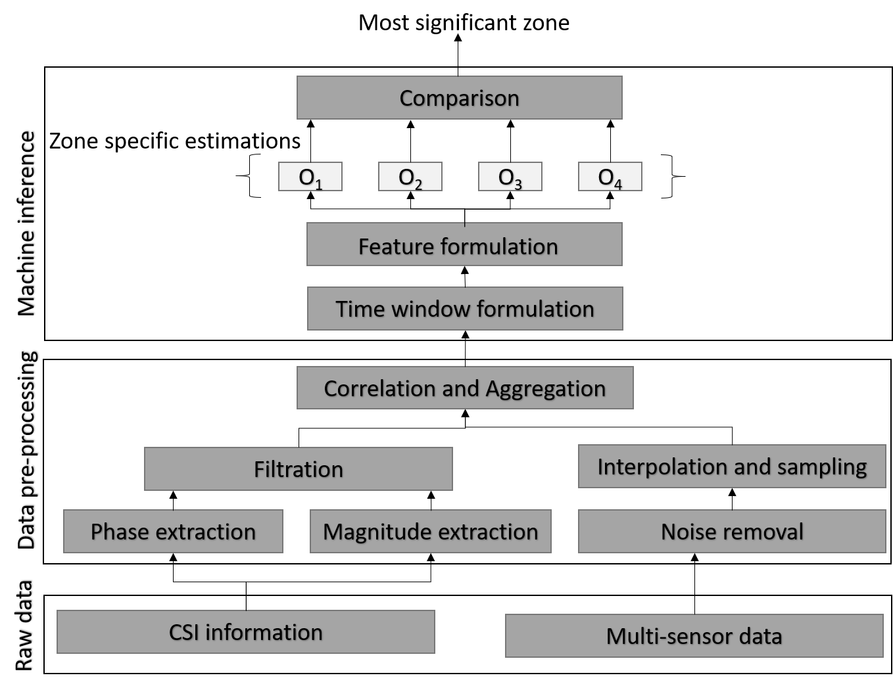
Pre-processing data

Slide 11
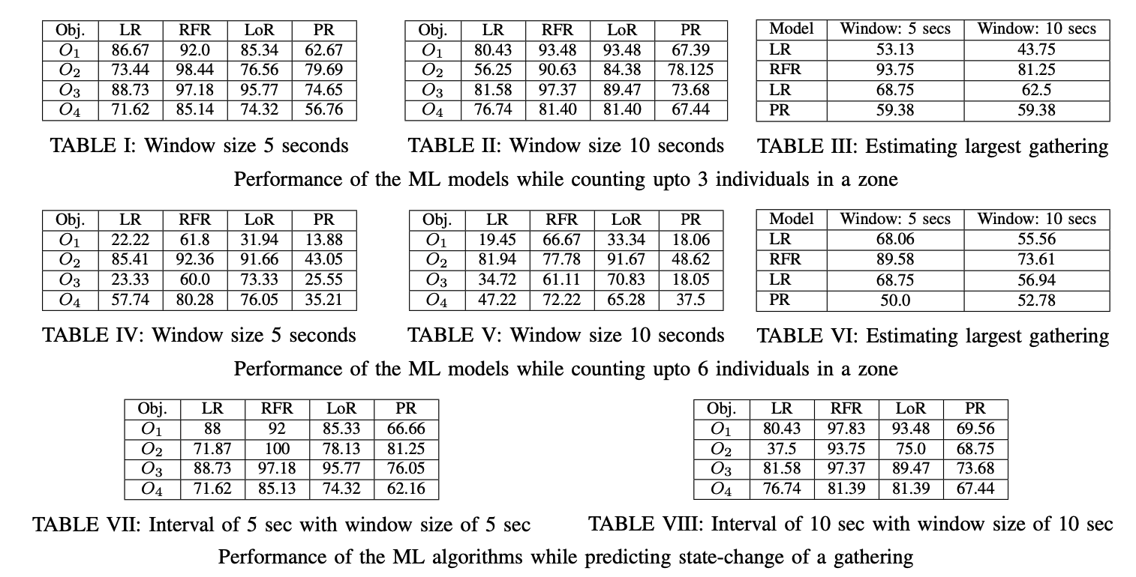
Results

Slide 12
Conclusion We addressed the problem of passive and interest-oriented crowd estimation. Challenges faced
Make the data temporally consistent
Data pre-processing
Contribution
Performing all the experiments in the paper.
Results and Analysis

Slide 13
Thank You !!!
Paper Link - https://ieeexplore.ieee.org/stamp/stamp.jsp?tp=&arnumber=9773844

